Slide 1




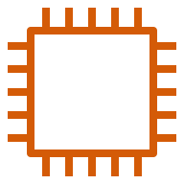

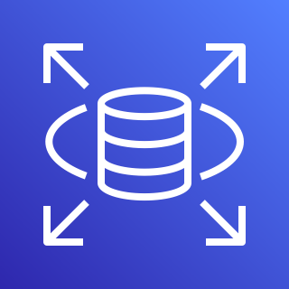
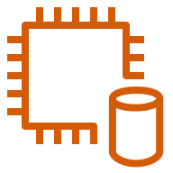
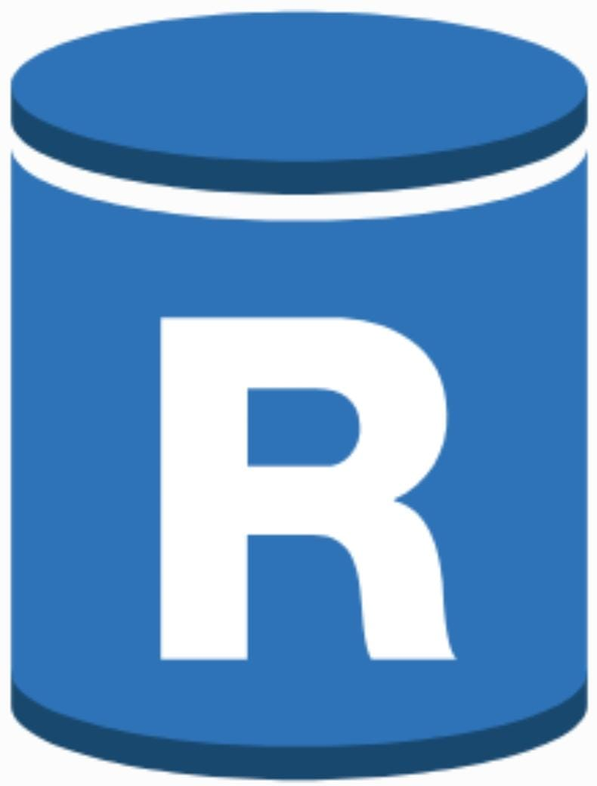
Architecture of AWS-RDS-Multi AZ-RR (Read Replica)
AWS Cloud
VPC
Subnet -1
Subnet - 2
Subnet - 3
EC2 instance contents
EC2 instance contents
EC2 instance contents
Instance -1
Instance -2
Instance - 3
RDS
Endpoint
DB-Instance 1
DB-Instance 2
Slave -1
DB-Instance 2
Slave -2
Master
RR -1
RR -2
RR -3

Slide 2

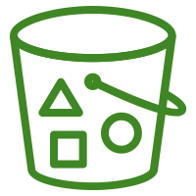
S3
Mumbai
S3
Northern
Versioning enable
Cross Region Replication
Versioning enabled

